Slide 1
MRA Project
Milestone 1
Submitted By : Renjith K P

Slide 2
Agenda
Contents of the Presentation
Problem Statement
Executive Summary
Exploratory Data Analysis
Customer Segmentation Using RFM

Slide 3
Contents of the Presentation
List of Tables | Slide No
Feature Description | 5
RFM Results | 30
Who are your best customers? | 31
Which customers are at the verge of churning? | 32
Who are lost customers? | 33
Who are your loyal customers? | 34
List of Figures | Slide No
Outlier Check | 7
Distribution Plot - Quantity Order & Price | 8
Country Wise Sales | 9
Country Wise Sales Across Years | 10
Year Wise Monthly Sales | 11
Monthly Sales Across Countries | 12
Year Wise Monthly Sales | 13
Country Wise Sales Across Quarters | 14
Product Line Sales Wise | 15
Weekly Sales Trend | 16
Top Customers By Sales | 17
Top 10 Customers Year Wise Sales Trend | 18
Customers Per Month | 19
Deal Size Across Countries | 20
Order Status | 21
Sales Trend | 22
Top – 5 Customers Quarter & Month Wise | 23
New Customer Growth | 24
RFM Segmentation | 28

Slide 4
Problem Statement
An automobile parts manufacturing company has collected data of transactions for 3 years. They do not have any in-house data science team, thus they have hired you as their consultant. Your job is to use your magical data science skills to provide them with suitable insights about their data and their customers.
Agenda & Executive Summary of the data
Contents of the presentation
Problem statement
About Data (Info, Shape, Summary Stats, your assumptions about data)
Exploratory Analysis and Inferences
Univariate, Bivariate, and multivariate analysis using data visualization
Weekly, Monthly, Quarterly, Yearly Trends in Sales
Sales Across different Categories of different features in the given data
Summarize the inferences from the above analysis
Customer Segmentation using RFM analysis (make 4 segments)
Which tool used?
What all parameters used and assumptions made
Output table head
Workflow image to be put when KNIME used
Inferences from RFM Analysis and identified segments
Who are your best customers? (give at least 5)
Which customers are on the verge of churning? (give at least 5)
Who are your lost customers? (give at least 5)
Who are your loyal customers? (give at least 5)

Slide 5
Executive Summary
There are 2747 entries and 20 features in the dataset
There were no null values of duplicated entries
The minimum sales is 482.13 and the maximum sales is 14082.8. Mean sales are 3553.04
12 features are of object data type, 5 are of int64 data type, 2 are of float datatype and one feature is of datetime64 data type
Data is of three years : 2018,2019 & 2020
Following are the feature descriptions
ORDERNUMBER : | Order Number | CUSTOMERNAME : | customer
QUANTITYORDERED : | Quantity ordered | PHONE : | Phone of the customer
PRICEEACH : | Price of Each item | ADDRESSLINE1 : | Address of customer
ORDERLINENUMBER : | order line | CITY : | City of customer
SALES : | Sales amount | POSTALCODE : | Postal Code of customer
ORDERDATE : | Order Date | COUNTRY : | Country customer
DAYS_SINCE_LASTORDER : | Days_ Since_Lastorder | CONTACTLASTNAME : | Contact person customer
STATUS : | Status of order like Shipped or not | CONTACTFIRSTNAME : | Contact person customer
PRODUCTLINE : | Product line – CATEGORY | DEALSIZE : | Size of the deal based on Quantity and Item Price
MSRP : | Manufacturer's Suggested Retail Price
PRODUCTCODE : | Code of Product

Slide 6
Exploratory Data Analysis

Slide 7
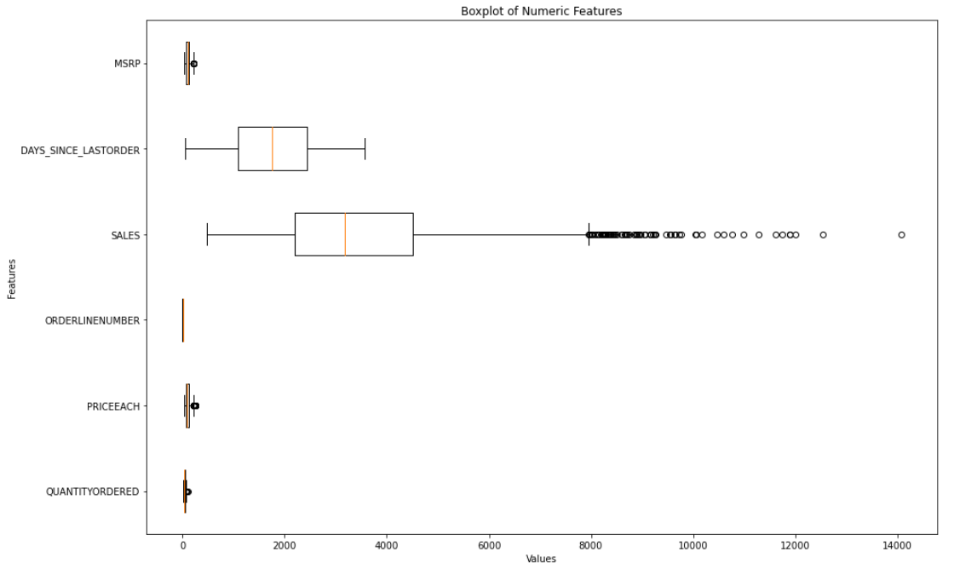
Outlier Check
Observations
There are some outliers present in features MSRP, Price each and Quantity ordered.
Sales has lot of outliers
Lets consider these as genuine values

Slide 8
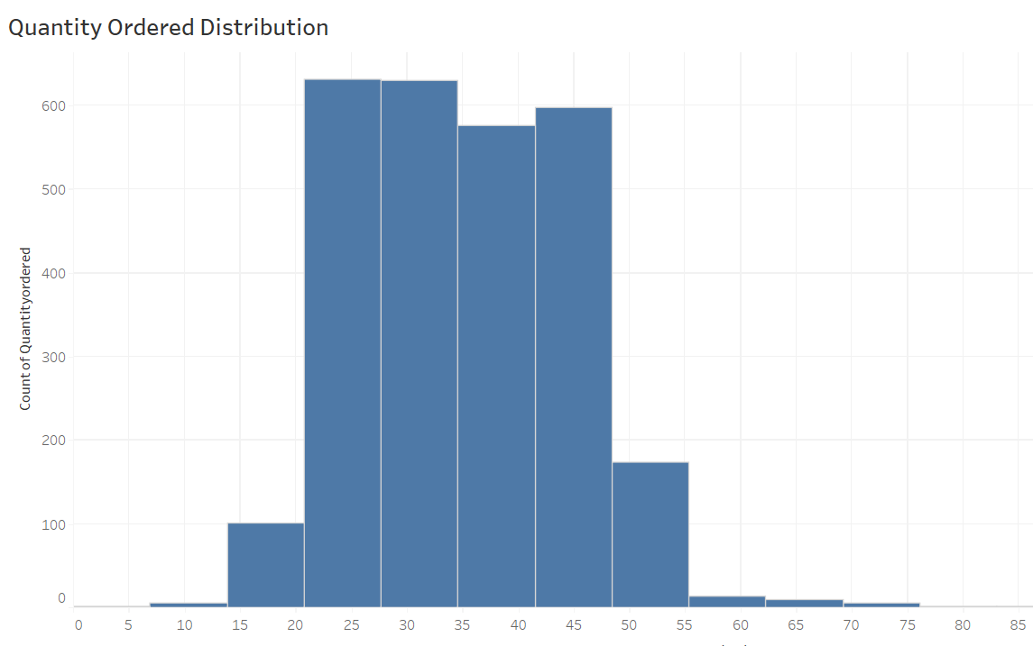
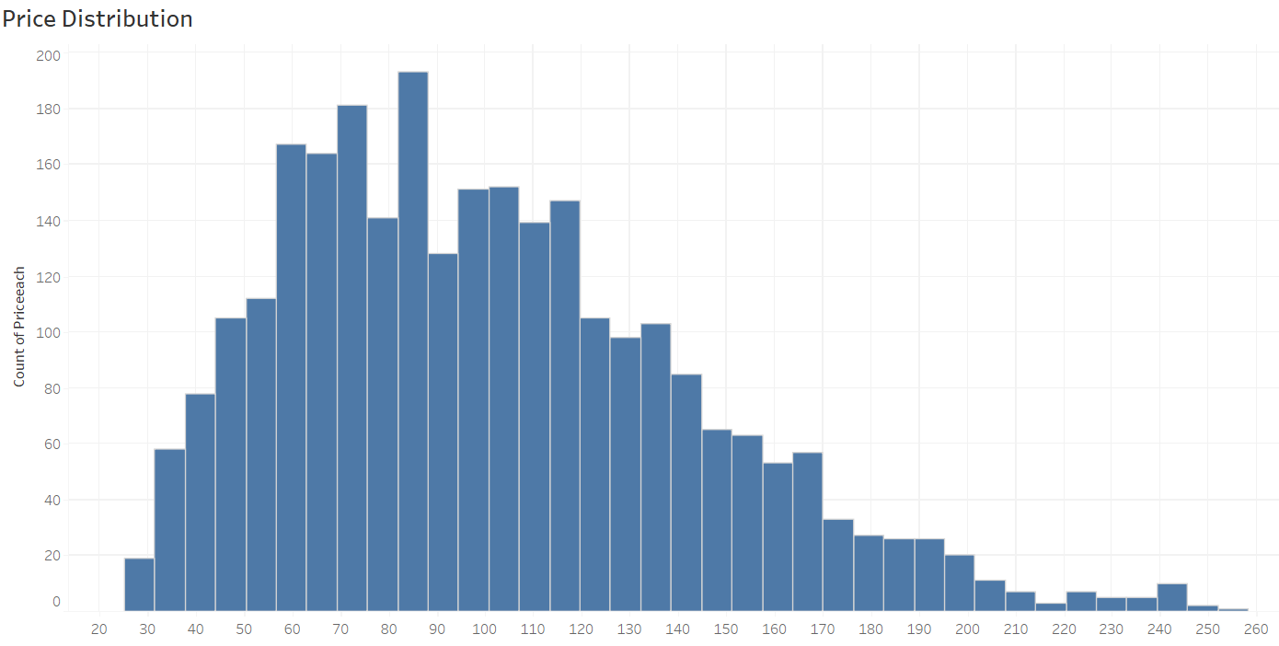
Data Distribution
Observations
Majority customer order quantity are in between 21 to 42
Price is right tailed and it ranges from 25 to 252

Slide 9
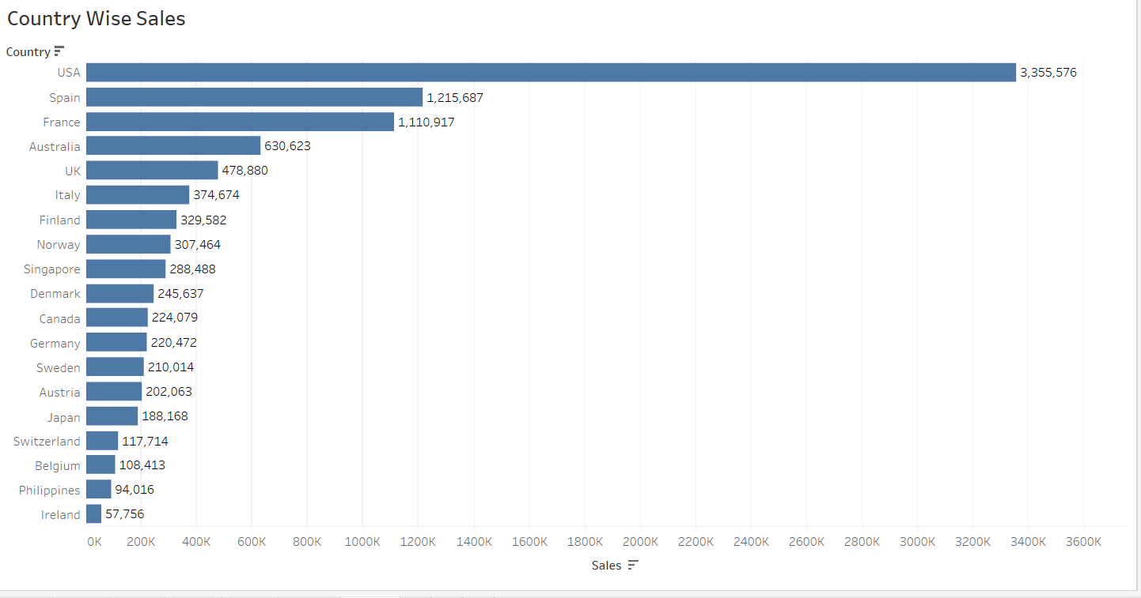
Country Wise Sales
Observations
The USA has the highest sales followed by Spain , France, Australia , UK , Italy , and Finland

Slide 10
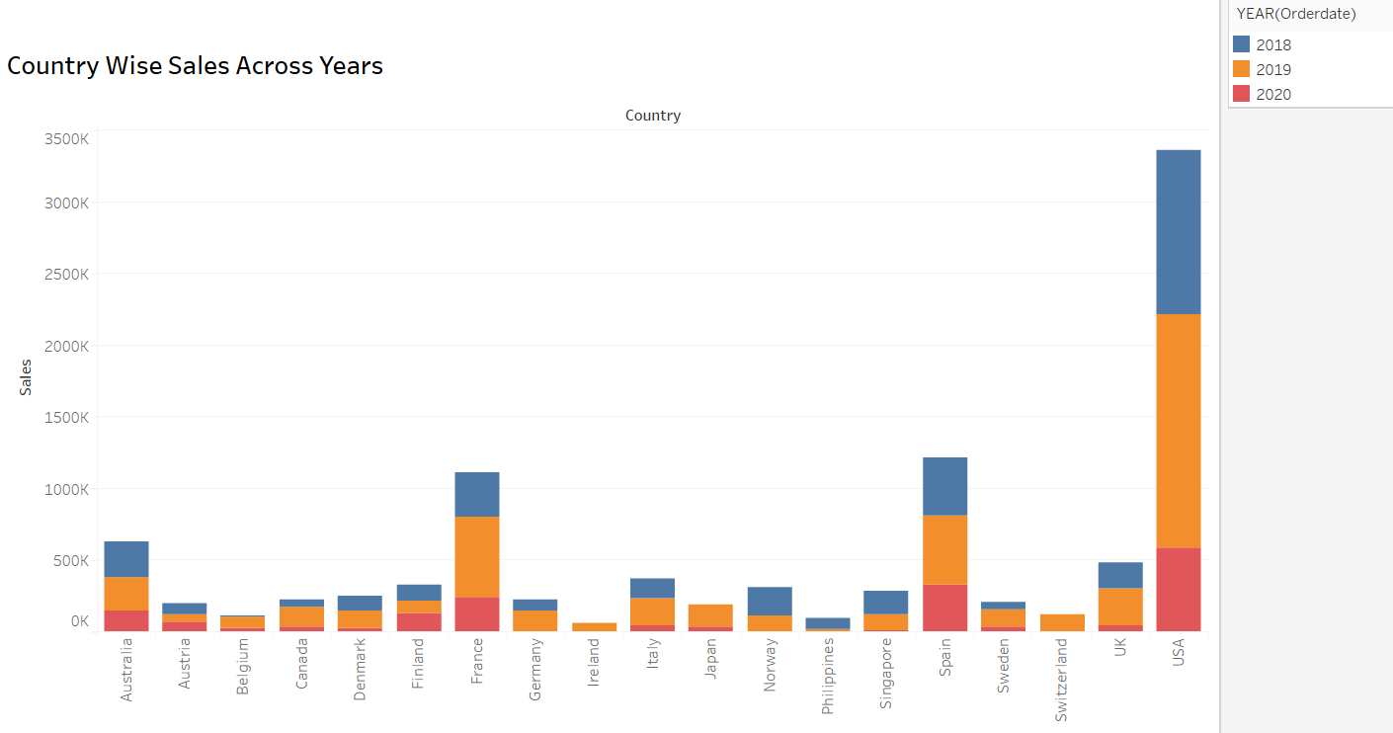
Country Wise Sales Across Years
Observations
There is an increase in 2019 sales compared to 2018 sales in countries USA, UK, Sweden , Germany , Denmark Spain, France, and Canada
Australia, Norway and Singapore are in decreasing trend for year 2019 compared to year 2018

Slide 11
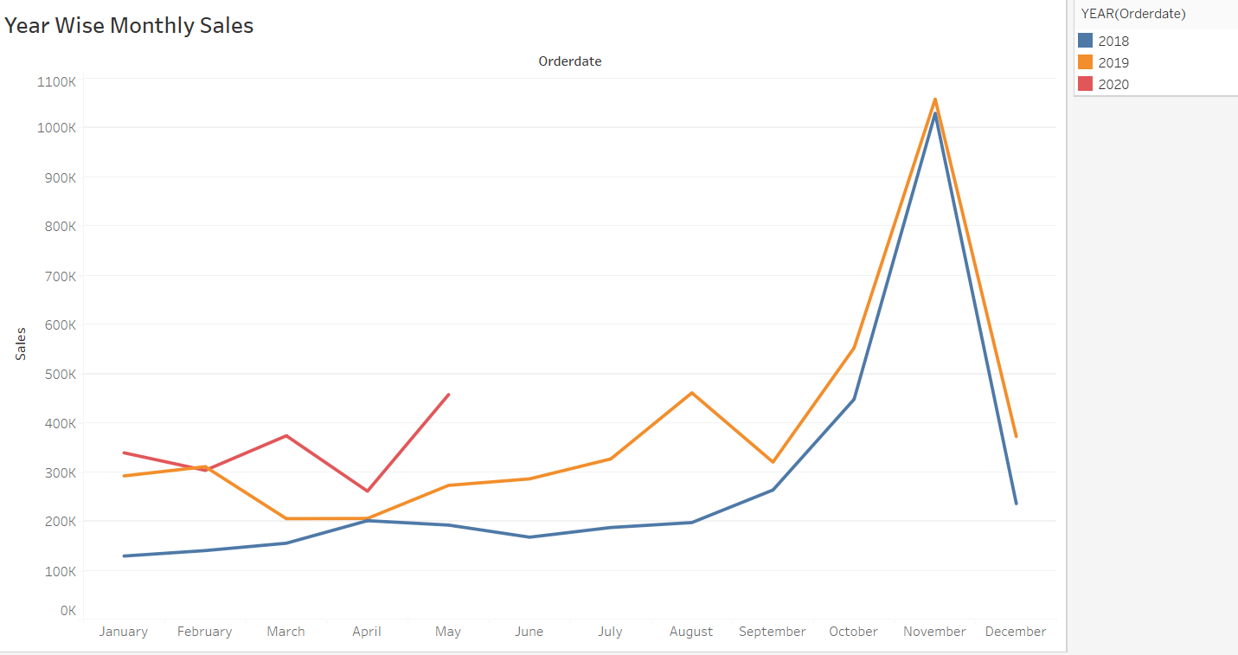
Year Wise Monthly Sales
Observations
Sales are high in November followed by October for the years 2018 and 2019
In 2020 only 5 months data is available

Slide 12
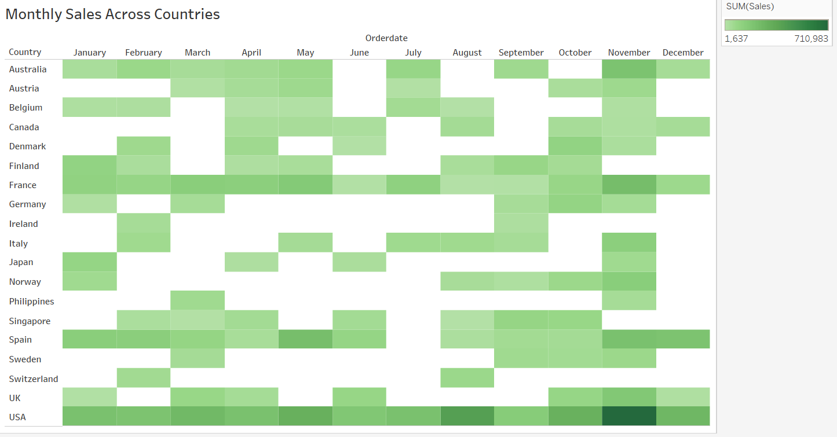
Monthly Sales Across Countries
Observations
November is showing peak sales trend for all 19 countries

Slide 13
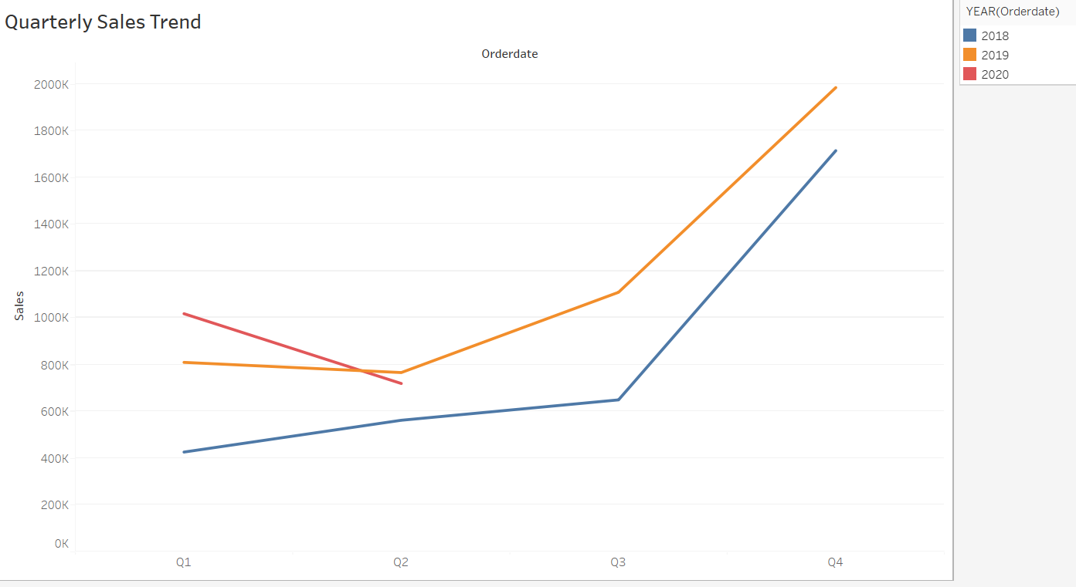
Year Wise Monthly Sales
Observations
Highest revenue is in 4th quarter for years 2018 and 2019

Slide 14
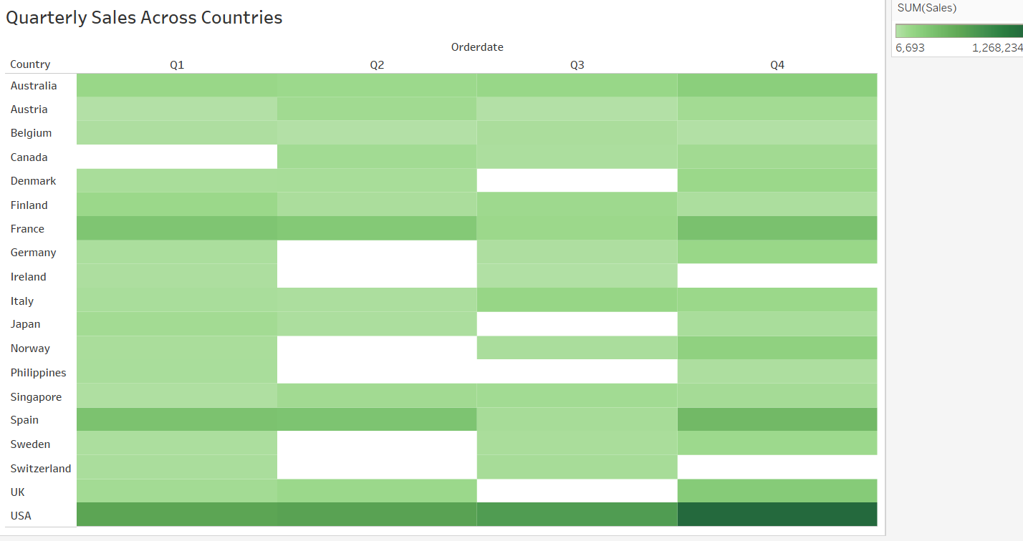
Country Wise Sales Across Quarters
Observations
Quarter 4 has highest sales for USA, Spain and France
There is a steady increase in sales trend in USA from Q1 to Q4
Many countries didn’t recorded any sales in some quarters

Slide 15
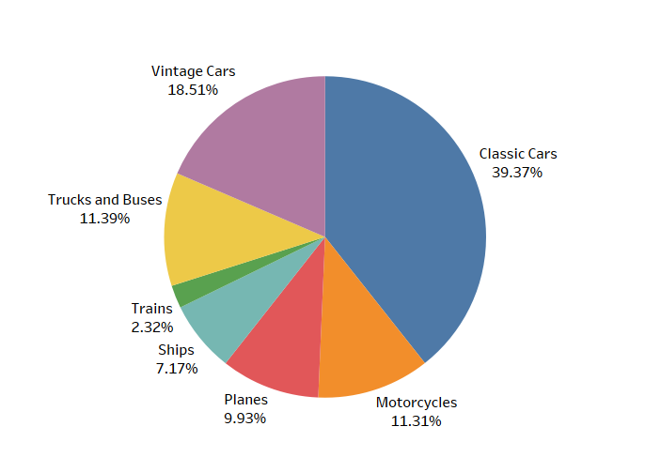
Product Line Sales Wise
Observations
Classic Cars have 39.37% share of total sales

Slide 16
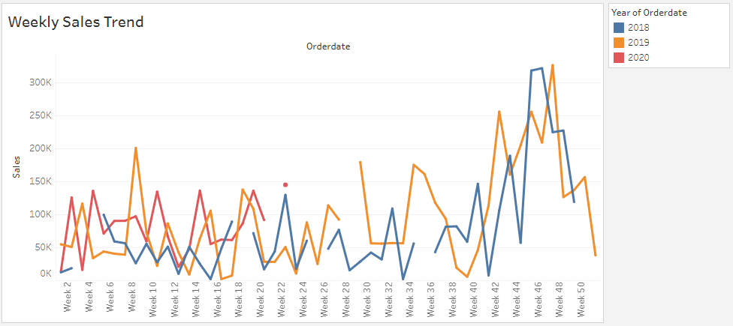
Weekly Sales Trend
Observations :
There are no pattern over weekly sales.
In the month of November higher sales are there

Slide 17
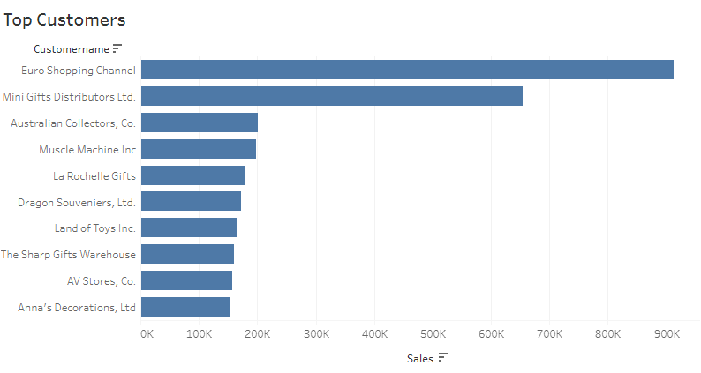
Top Customers By Sales
Observations :
Top 5 customer with respective to sales are
Euro Shopping Channel
Mini Gifts Distributors Ltd.
Australian Collectors, Co.
Muscle Machine Inc.
La Rochelle Gifts

Slide 18
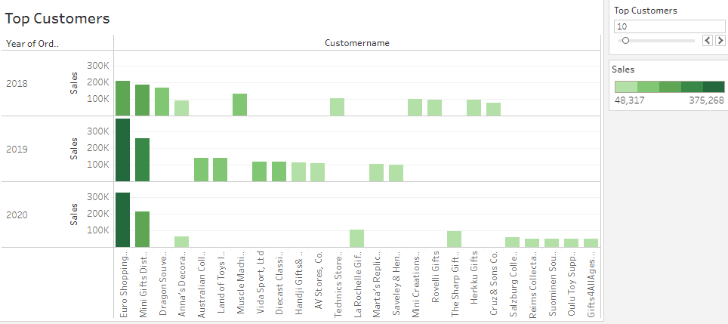
Top 10 Customers Year Wise Sales Trend
Observations :
Top two customers are same every year
Other customers in top 10 varies every year

Slide 19
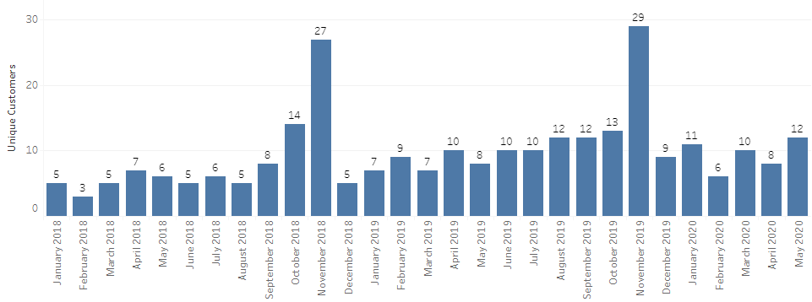
Customers Per Month
Observations :
Number of unique customers are high in September , October and November months in 2018 and 2019
In 2020 maximum unique customers are in January, March and May which is equal to some of the high numbers in 2018 & 2019
Data shows number of customers increased in 2020 in the starting of the year

Slide 20
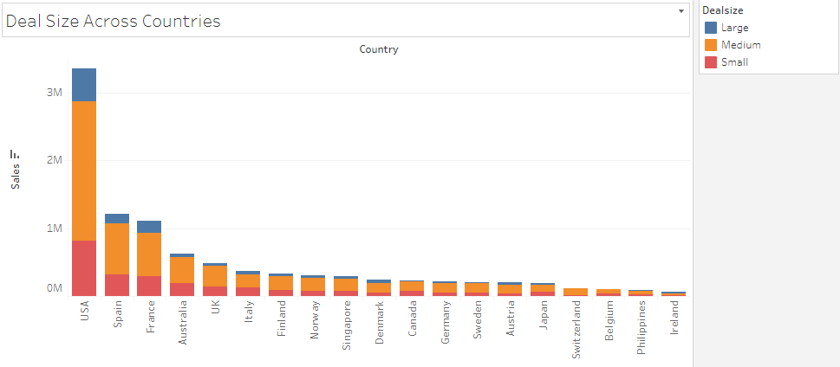
Deal Size Across Countries
Observations :
Maximum sales are generated from medium size deals
Least sales generated from large size deals

Slide 21
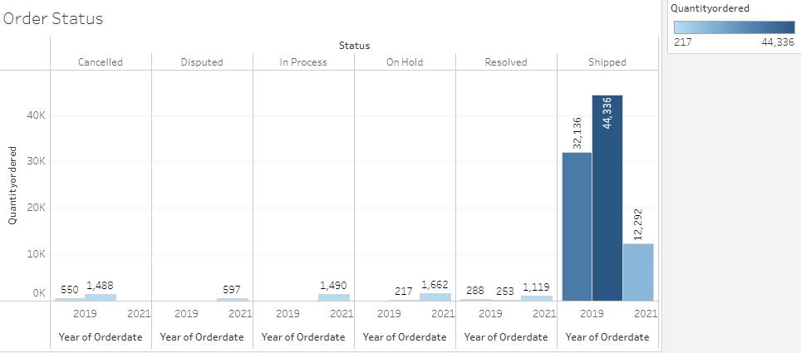
Order Status
Observations :
Majority of the orders shipped
Most number of cancelled orders were in 2019

Slide 22
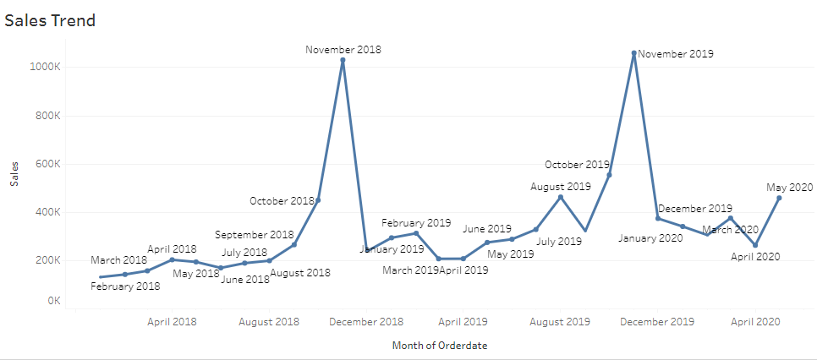
Sales Trend
Observations :
Higher sales recorded in November 2018 & 2019

Slide 23
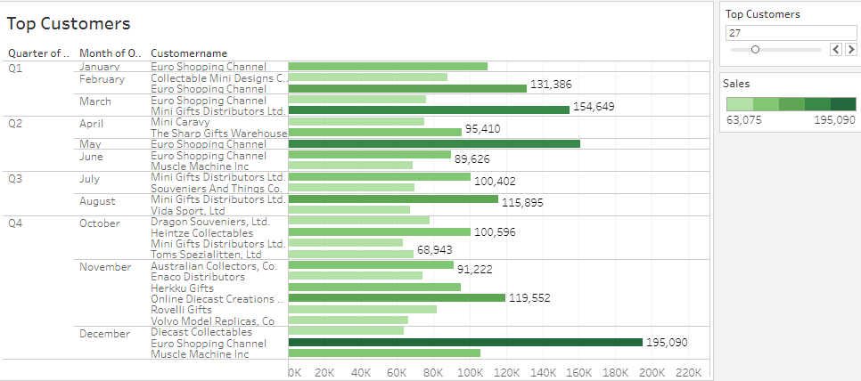
Top – 5 Customers Quarter & Month Wise
Observations :
Euro Shopping Channel is a premium customer

Slide 24
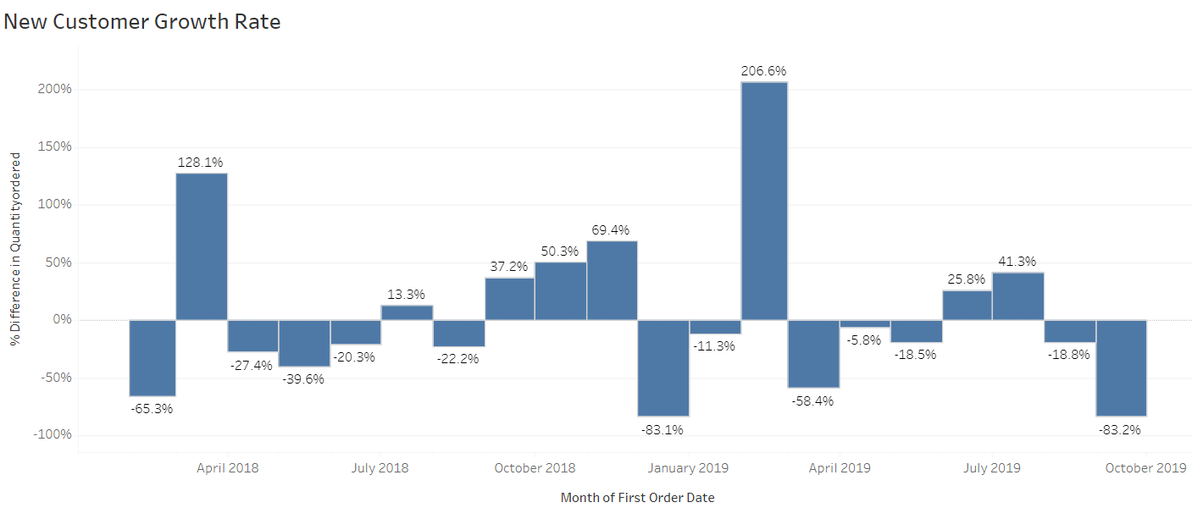
New Customer growth
Observations :
The highest customer growth rate is in the month of Feb 2019

Slide 25
Key Observations
89 customers are there from 19 countries
Majority of the customers ordered quantity in between 20-40
Product price ranges from 26 to 252
November month revenue is highest for years 2018 and 2019. October and November sales are higher compared to other months.
USA is the country with highest sales compared to other countries followed by Spain, France , Australia , UK , Italy , Finland & Singapore
When we observed the sales trend from 2018 to 2019 it seems that sales increased in following countries : USA, Spain , France and Canada. Sales decreased in following countries : Australia, Norway and Singapore
USA recorder highest sales in Quarter 4. Also in Australia, Denmark, France, Germany, Norway and UK highest sales recorded in Quarter 4

Slide 26
Key Observations
Top 2 customers are Euro Shopping Channel and Mini Gifts Distributors Ltd
Number of unique customers are high in September , October and November months in 2018 and 2019. However in 2020 maximum unique customers are in January, March and May which is equal to some of the high numbers in 2018 & 2019. Data shows number of customers increased in 2020 in the starting of the year
Top two customers are same every year. Other customers in top 10 are different each year
Highest new customer growth is in 2019 February.
High number if cancelled orders seen in 2019
Product line Classic Cars has about 39% share of total sales
Top 2 customers are Euro Shopping Channel and Mini Gifts Distributors Ltd

Slide 27
RFM Analysis

Slide 28
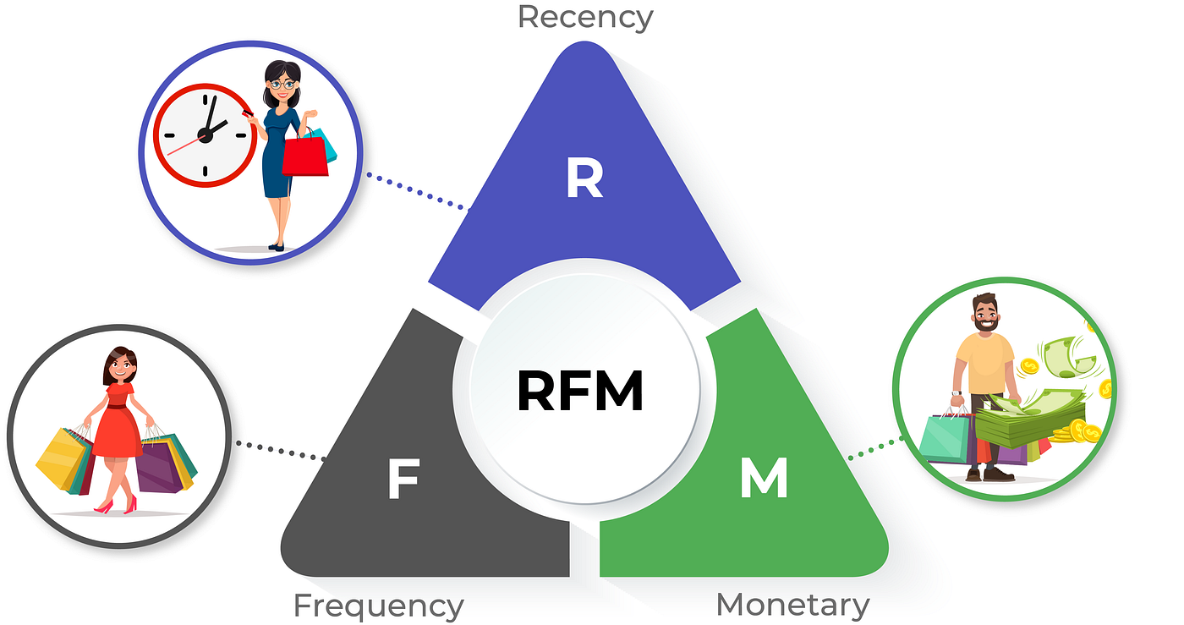
Customer Segmentation Using RFM
RFM (Recency, Frequency, Monetary) is a popular method for customer segmentation in marketing and customer relationship management. It helps businesses understand and classify their customers based on their purchasing behavior.

Slide 29
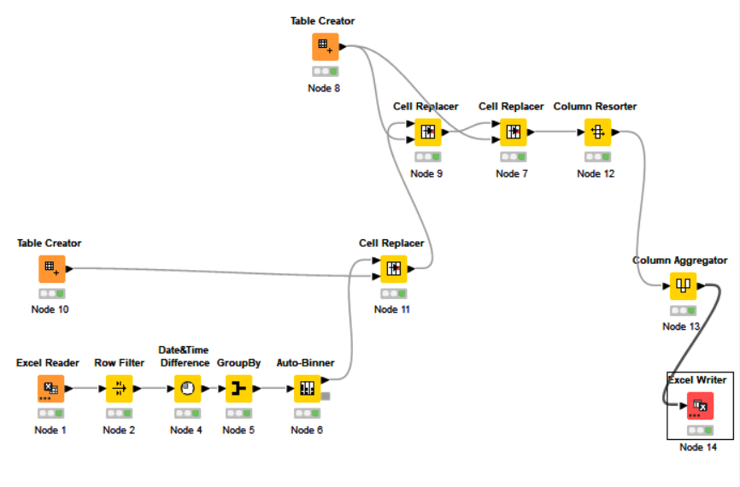
RFM Analysis Using KNIME
KNIME Workflow
Segmented Customers into 4 segments
Recency – 4 mean most recent
Frequency and Monetary – 4 means most Frequent
and Monetary
Grouped data by Customer Name.
Aggregation taken –
Unique Count(Orders) for Frequency
Sum of Sales for Monetary
Minimum of Days Since Last Order

Slide 30
RFM Results
CUSTOMERNAME | RFM Score
Danish Wholesale Imports | 444
Diecast Classics Inc. | 444
Euro Shopping Channel | 444
La Rochelle Gifts | 444
Mini Gifts Distributors Ltd. | 444
Reims Collectables | 444
Salzburg Collectables | 444
Souveniers And Things Co. | 444
The Sharp Gifts Warehouse | 444
Handji Gifts& Co | 443
Tokyo Collectables, Ltd | 443
L'ordine Souveniers | 424
Auto Canal Petit | 423
Gift Depot Inc. | 423
UK Collectables, Ltd. | 423
Gifts4AllAges.com | 422
Lyon Souveniers | 422
Mini Caravy | 422
Petit Auto | 422
Quebec Home Shopping Network | 422
Tekni Collectables Inc. | 422
Alpha Cognac | 421
Australian Collectables, Ltd | 421
Top 23 Customers with Highest RFM scores

Slide 31
Who are your best customers?
Customers with highest recency, highest frequency and highest monetary

Slide 32
Which customers are on the verge of churning?
Customers who's recency value is low

Slide 33
Who are lost customers?
Customers who's recency, frequency as well as monetary values are low

Slide 34
Who are your loyal customers?
Customers with high frequency value

Slide 35
Thank You

